Slide 1

TECH TALKS
Tech at Work
How technology affects companies and employees

Slide 2

Table of Contents
Points for discussion:
How tech affects companies
The ease of setting up a remote team
Keeping your company and employees safe
The benefits of technology in the workplace
Is remote work here to stay?
What's next in tech workspace

Slide 3

How tech affects companies, no matter
the industry
Whether you're in education, medicine, or engineering, how you work has been vastly affected by technological advancements, including new computers, data software and various tools people did not have access to in decades past. From the way you tackle your tasks to how you communicate with coworkers, technology has created ripples of change that have benefited companies in every industry.

Slide 4
How people worked without tech
Longer time is spent on individual tasks.
Communication was more complex and tedious.
Managing data was done manually and involved a ton of paperwork.
How people work with tech
New tools enable work to be done much faster and easier.
Communicating with colleagues, no matter where they are in the world, is incredibly fast and convenient.
Everything is digital and easier to file, manipulate or keep track of.

Slide 5

The ease of setting up a remote team
Step 1
Step 2
Step 3
Step 4
Step 5
Maintain team engagement.
Recruit with scrutiny.
Invest on cloud technology.
Maintain team engagement.
Maximise communication.
Every employee
must be aware
of all the rules.
Know which candidate is most reliable and apt
for the post.
Make everything convenient and safe.
Keep in touch through regular meetings and
check-ins.
Use the same communication platforms within
the company.

Slide 6
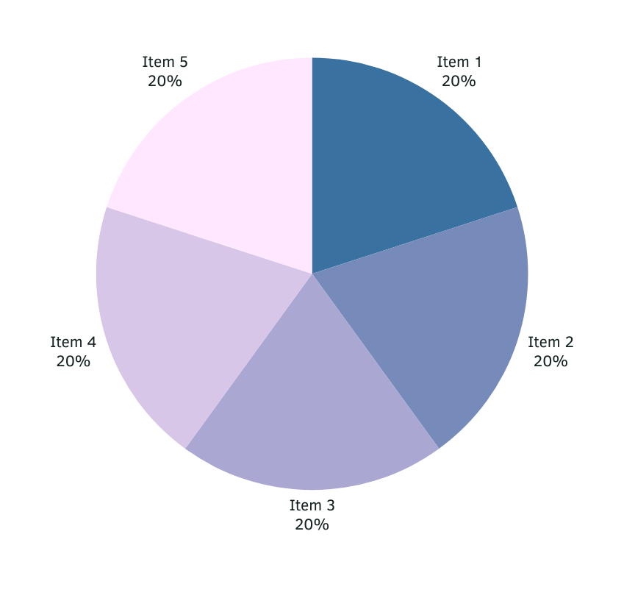
Remote Work Suitability by Industry
As of January 2021
More and more companies realise that specific job titles and profiles can be accomplished while working from home.

Slide 7



Keeping your company and employees safe
The importance of cybersecurity in the workplace
Avoid compromising the security of the platforms you use within the company by investing heavily in cybersecurity. Secure your company's data by looking into the best platforms out there that can protect against cybercriminals, hackers and other fraudulent acts.

Slide 8

The Benefits of Technology in the Workplace

Slide 9
On Company Growth
How tech helps companies evolve and innovate
New Avenues for Progress
Ease of
Management
Better Platforms
for Employees
Technology presents new ways to engage with consumers
and provide new services
they may need in this age
of advanced tech.
Businesses are now able to improve the way they operate, from streamlining processes
to handling consumer transactions.
Employees have access to
a vast array of tools to improve the way they work, no matter how complex a task.

Slide 10
On Employee Happiness
Easier Ways of Working
Several platforms offer different tools and features employees can use to make each task more convenient
and effective.
Faster Means of Communication
Interacting with colleagues and sending out a message
to anyone in and out of the country takes no time at all.
How tech makes accomplishing work easy and satisfying
Effective Time Management
Getting work done faster means employees can dedicate more time to life outside of work, especially for remote positions.

Slide 11

Is remote work here to stay?
How working from home might be the way to go
Now that it's become even more evident that finishing tasks and communicating with colleagues can all be quickly done even when every employee stays at home, plenty of companies see how remote work is the better path to take. It's cost-effective, easy and safe, so it's no wonder why some businesses are starting to make remote work the norm.

Slide 12
While remote work has its perks,
the ability to switch off after a day's work may be even more difficult as you find that the space you spend hours working in is the same space that used to only be for rest and relaxation.

Slide 13

What's Next in Tech Workspace
Increased task automation and use of artificial intelligence.
Extra focus on high-value tasks.
Continuous investment in cybersecurity and security technology.
A better conscious focus on mental health.
Greater geographic distribution and representation of the workforce.

Slide 14

Science and technology revolutionise our lives, but memory, tradition and myth frame
our response.
- Arthur Schlesinger

Slide 15
Do you have
any questions?
Send it to us! We hope you learned something new.

Slide 16
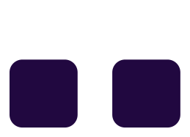

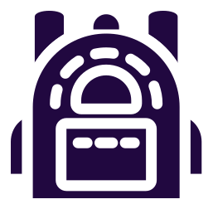













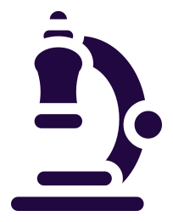
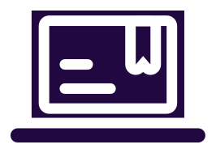











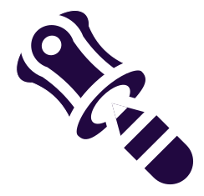
Free Icons
Use these free recolourable icons
and illustrations in your Canva design

